Slide 1

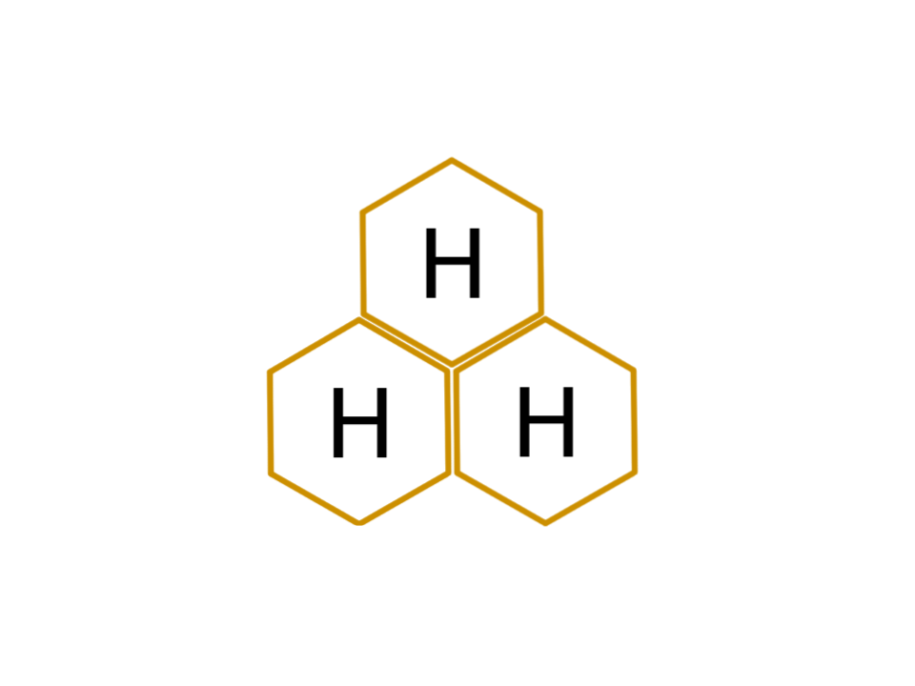
Senior Design Conference
Hiv3: An Efficient Beehive Monitoring System
Aneal Kuverji, Connor Merhab, Jack Ursillo, Anshuman Sahu
Advisors: Dr. Behnam Dezfouli, Dr. Shiva Jahangiri,
Gerhard Eschelbeck, Lisa Eschelbeck
May 2024
Notes:
Practice Run: 5/6 (2:30 sec left from 25 min pres) (demo time…?)

Slide 2
Outline
Motivation
Current Solutions
Our Solutions
System Overview
Demo
Testing and Evaluation
Future Work
Q & A
Notes:
AK

Slide 3

Motivation
Hiv3

Slide 4
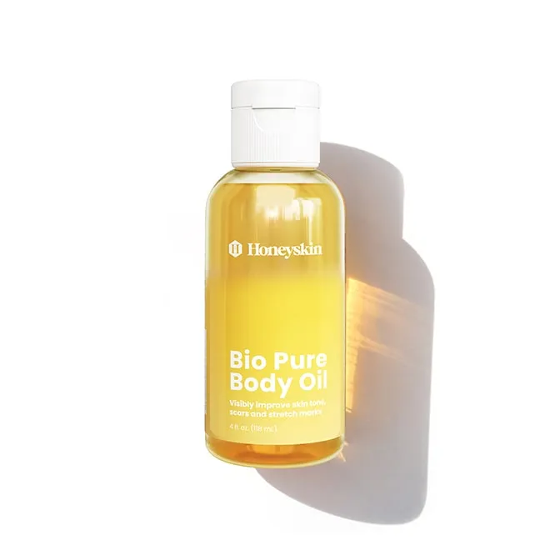
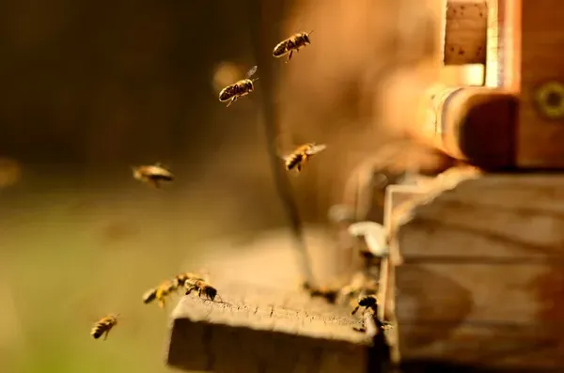
Motivation
Bees play a vital role
Global agriculture
Health products
Beauty cosmetics
Candles
Healthy hives = higher honey yield
Bio-Pure Body Oil for Stretch Marks & Scars - Honeyskin
Notes:
AK

Slide 5
Current Solutions
Hiv3

Slide 6



Current Solutions
Solutions | Scalability | Installation | Accuracy | Efficient | Cost
apic.ai [2] | Low | Easy | High | High | $10,000+
Broodminder [3] | Low | Medium | Very High | Low | $289-$339
Eyesonhives [4] | Low | Easy | High | High | $239
Notes:
AK

Slide 7
Proposed solution
Hiv3

Slide 8

Proposed solution
A secure exterior monitoring system
Utilizes ML to analyze bee behavior
Displays count of bees on user interface
Dynamic resolution
Image gallery
Notes:
CM
Monitoring System
Uses ML to get Bee Count
Want user interface to display bee count

Slide 9
Why Hiv3?
Solutions | Scalability | Installation | Accuracy | Efficient | Cost
apic.ai [2] | Low | Easy | High | High | $10,000+
Broodminder [3] | Low | Medium | Very High | Low | $289-$339
Eyesonhives [4] | Low | Easy | High | High | $239
Hiv3 | High | Easy | High | High | $80+ $85/unit + $7/month
Breakdown of Cost:
Raspberry Pi 5: $60-80 (x1)
Lunis Solar Power Battery: $35 (per unit)
PowGrow Solar Panel: $30 (per unit)
Camera: $10 (per unit)
MicroUSB to USB-A 10 ft cable: $10 (per unit)
Heroku: $7 (per month)
Notes:
CM + AK
Other solutions shine in one area
Go into each reason our product shines in all areas

Slide 10
Requirements & Constraints
Non-Functional Requirements
Secure
Reliable
Easy to use
Easy to install/setup
Constraints
Low-power efficient system
Cost effective
Open-source
Unique user access
Remote and local accessibility
Simultaneous live stream and photo capture
Notes:
AS

Slide 11
System Overview
Hiv3

Slide 12
Design Rationale
ESP32 Camera
Inexpensive, provides high resolution images, secure, low power
Solar Panel and Battery
Powers the system, sustainable
Raspberry Pi
Powerful, manages ESP32, remote management
Edge Server
Powerful, used to compile machine learning model
Heroku
Inexpensive, scalable, hosting
MongoDB
Performance, stores user roles and processed data
React
Easy to use, displays metrics on dashboard
Yolo V8
Accurate, quick, open source
Cloudflare
Industry standard, secure, scalable, reliable
Notes:
Jk

Slide 13
Risk Analysis
Risk | Likelihood | Impact | Risk Rating | Response
Not enough sunlight | 3 | 4 | 12 | Battery is USB-C chargeable, solar panel can be repositioned
Camera “browns out” | 2 | 5 | 10 | Camera will need to be replaced
Unauthorized user access | 1 | 3 | 3 | Non-authorized users are guests with limited access
Cloudflare goes offline | 1 | 5 | 5 | Wait for reconnection
Likelihood values: 1 - Very unlikely
2 - Not likely
3 - Possible
4 - Probable
5 - Very likely
Impact values: 1 - Negligible
2 - Low
3 - Moderate
4 - Significant
5 - Catastrophic
Risk Rating
[1-6] - Low
[7-12] - Medium
[13-25] - High
X
=
Notes:
AK

Slide 14
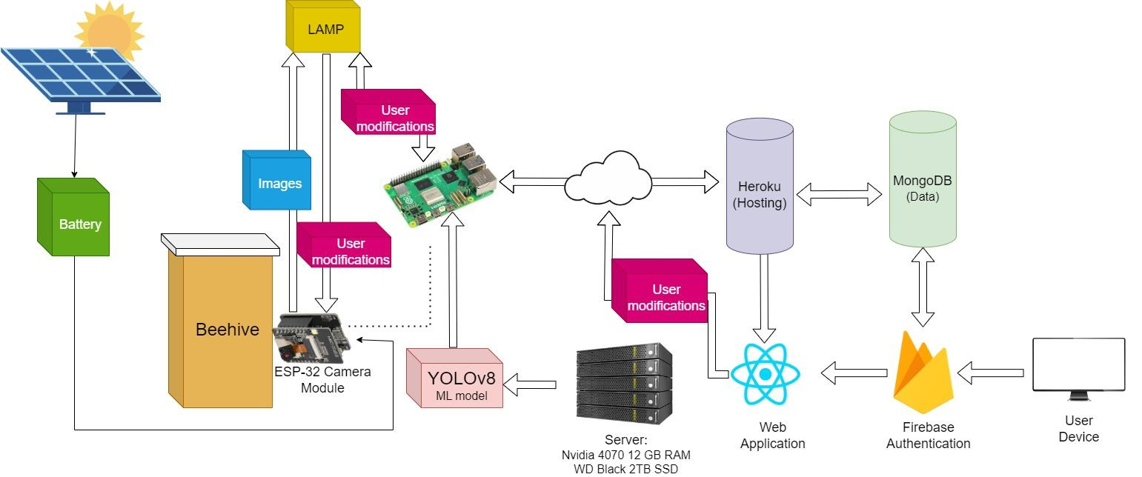
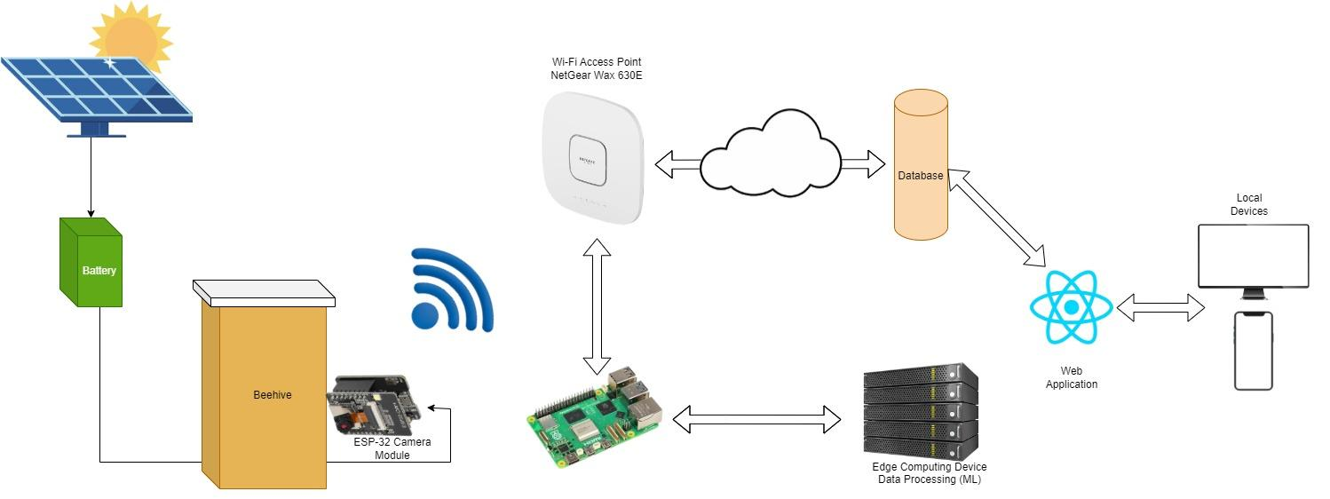
High Level Overview
Notes:
Aneal

Slide 15
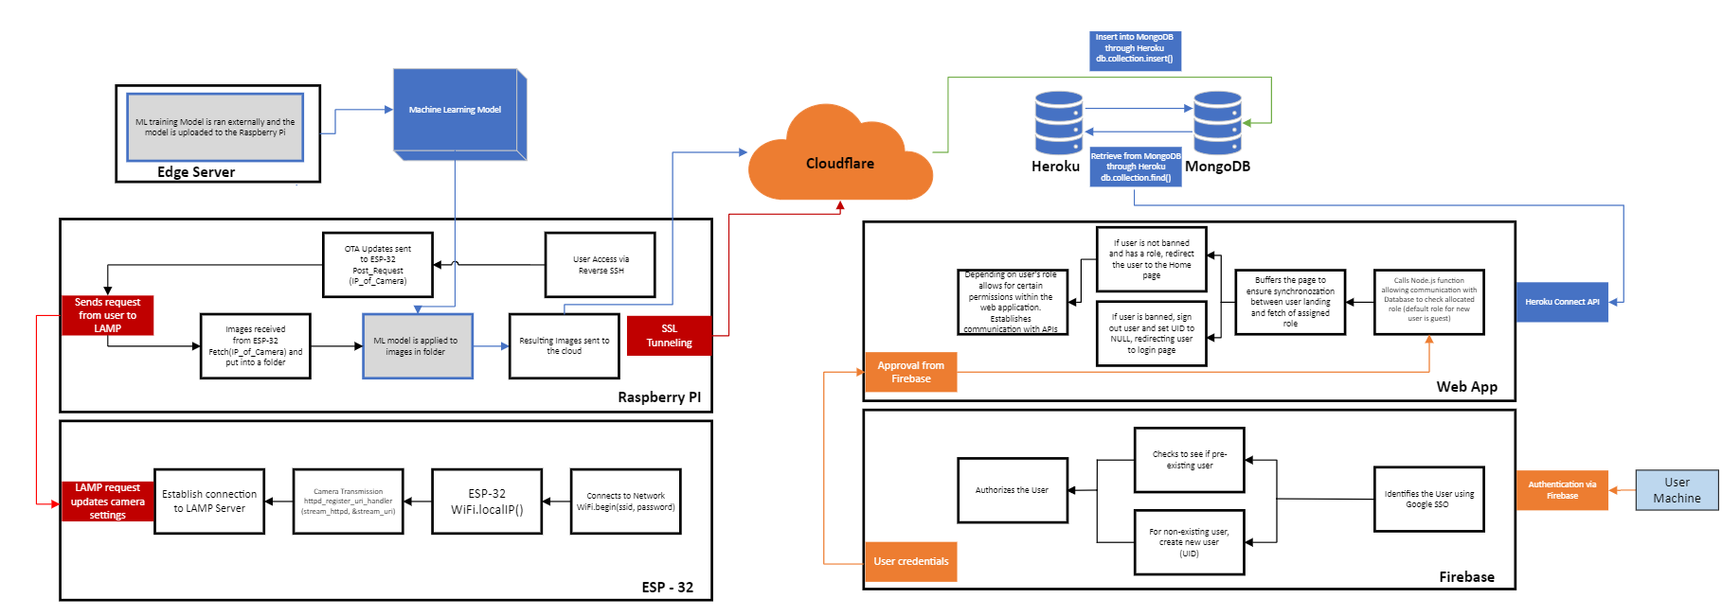
System Architecture (whole view)
Notes:
Jack

Slide 16
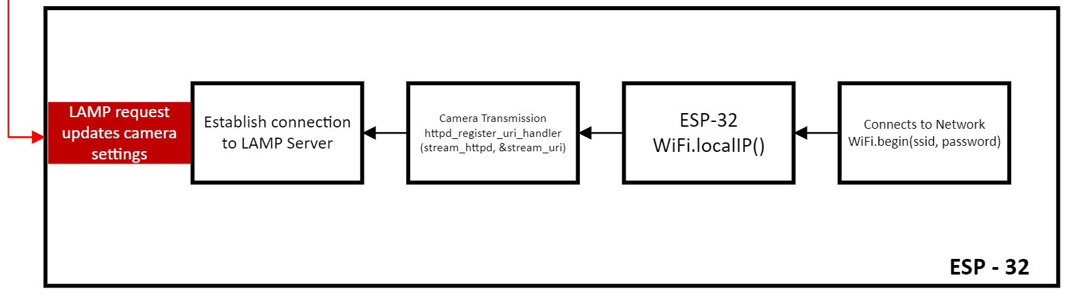
System Architecture (cont.)
Notes:
Jack

Slide 17
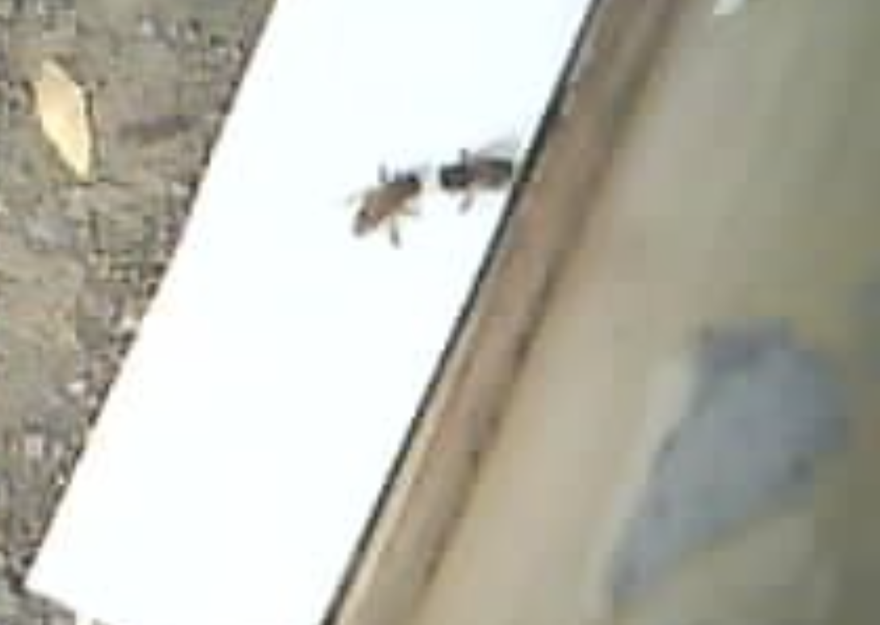
ESP32
Able to take different range of images
Secure OTA updates from the Raspberry Pi
Connects to user’s local IP
Deep sleep capabilities allow for efficient power consumption
Photo used in ML
model captured on ESP-32
Notes:
Jack

Slide 18
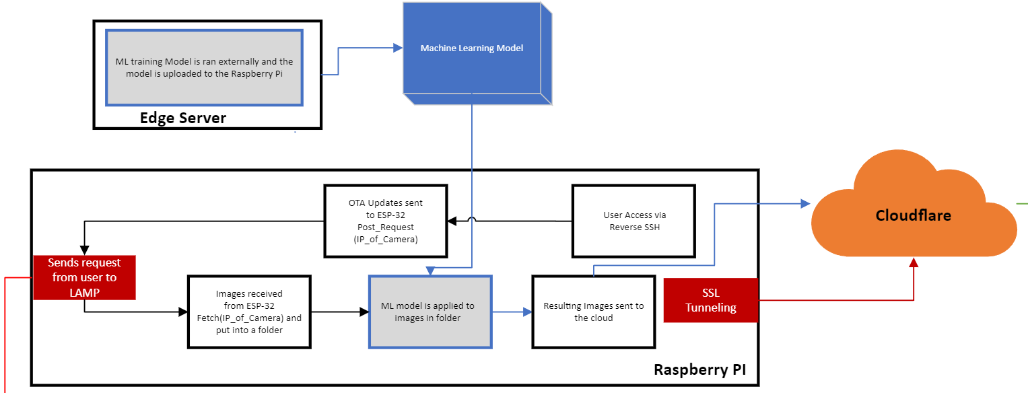
System Architecture (cont.)
Notes:
Jack

Slide 19
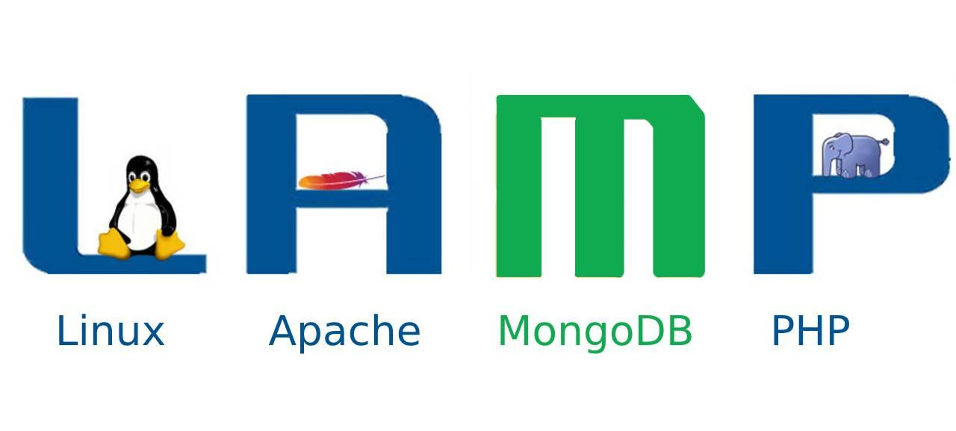
Raspberry Pi
Manages the cameras
Handles esp OTA requests
Access point that establishes communication with cloud
Watchdog
Upon folder change send new packages to the database
Machine Learning
Makes a prediction on images
Notes:
Jack

Slide 20
Security & Privacy
Industry standard solution
Additional security features
Scalable
Cost effective
SSL Tunnel/Domain
Raspberry Pi establishes one way communication
Cloudflare handles HTTPS requests
Authentication page requiring SSO to prevent non-whitelisted users
Reverse SSH connection to Raspberry Pi to prevent unauthorized external requests
Notes:
JK

Slide 21
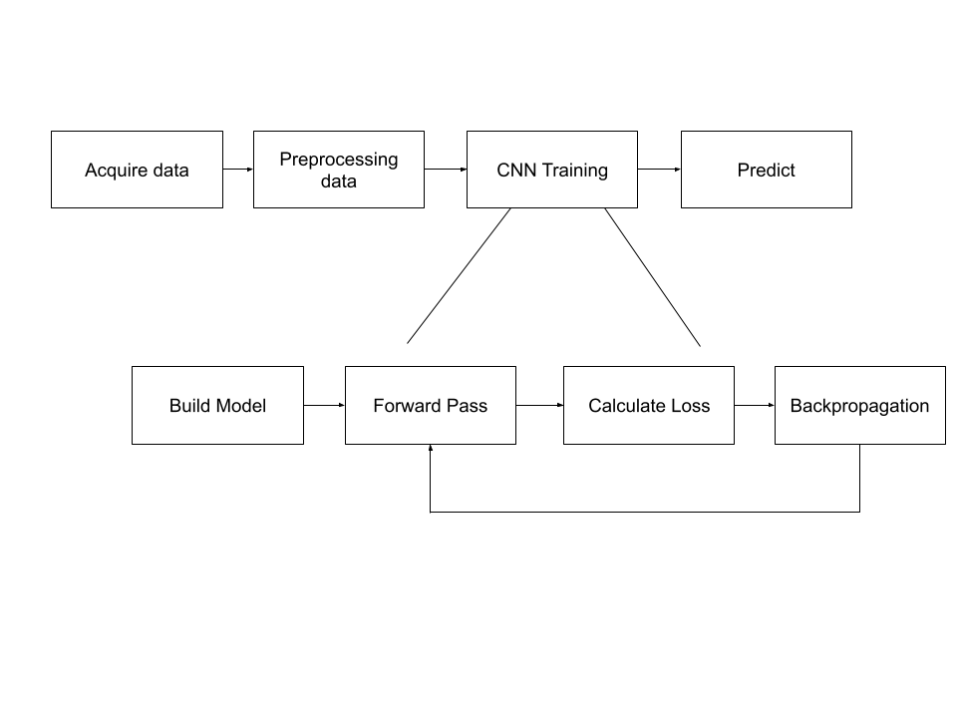
Machine Learning Basics
Notes:
AS

Slide 22
YOLOv8
A machine-learning model framework for object detection
Real time prediction
Reads the image once
Makes boundary boxes and classifies each bees within the boundary box
Can detect whether a bee is carrying pollen or not
Trained this model with a NVIDIA RTX 4070 GPU
Allows us to use CUDA to speed up training process
Utilizes an external library to track bees
Can track how many bees go in and out of the hive
Notes:
AS

Slide 23
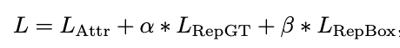
Repulsion Loss
Because bees stick close together and overlap one another, it is hard for an ML model to track and differentiate from one another
Solution: Repulsion Loss
There are three main components to repulsion loss:
Attraction with associated box (Attr)
Repulsion from other predictions (RepBox)
Repulsion from other ground truths (RepGT)
Notes:
AS

Slide 24
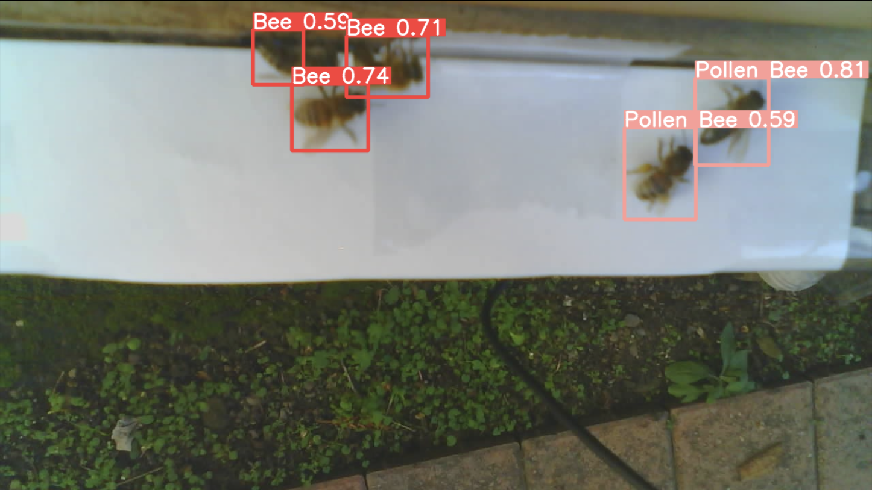
Test images
Notes:
AS

Slide 25
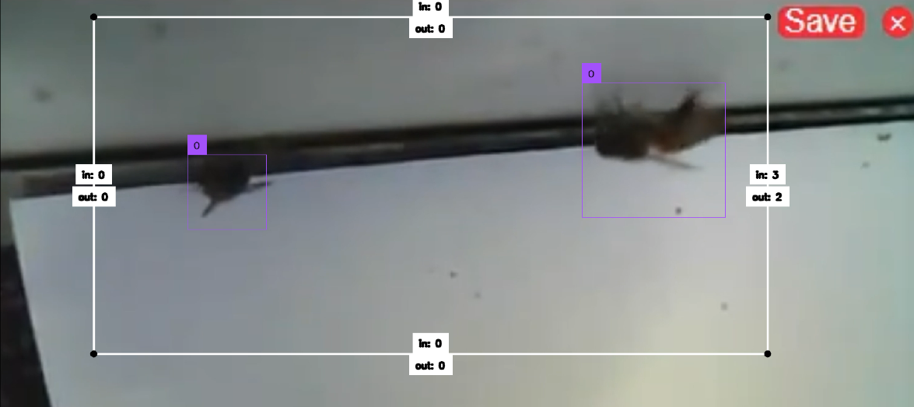
Test images (cont.)

Slide 26
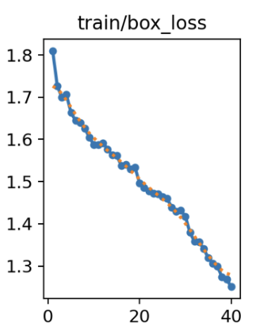
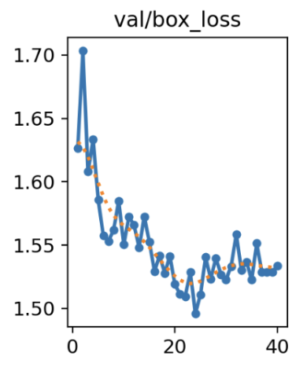
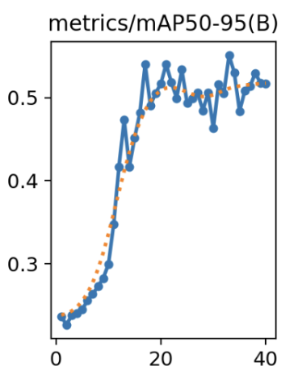
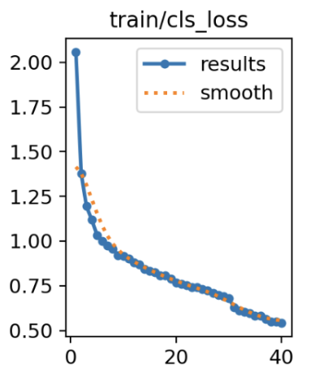
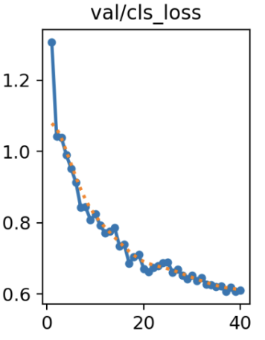
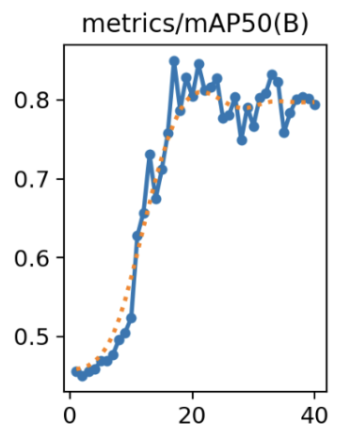
Train Loss Graphs
Mean Average Precision
Loss
Loss
Epochs
Epochs
Epochs
Mean Average Precision
Loss
Loss
Epochs
Epochs
Epochs
Notes:
AS

Slide 27
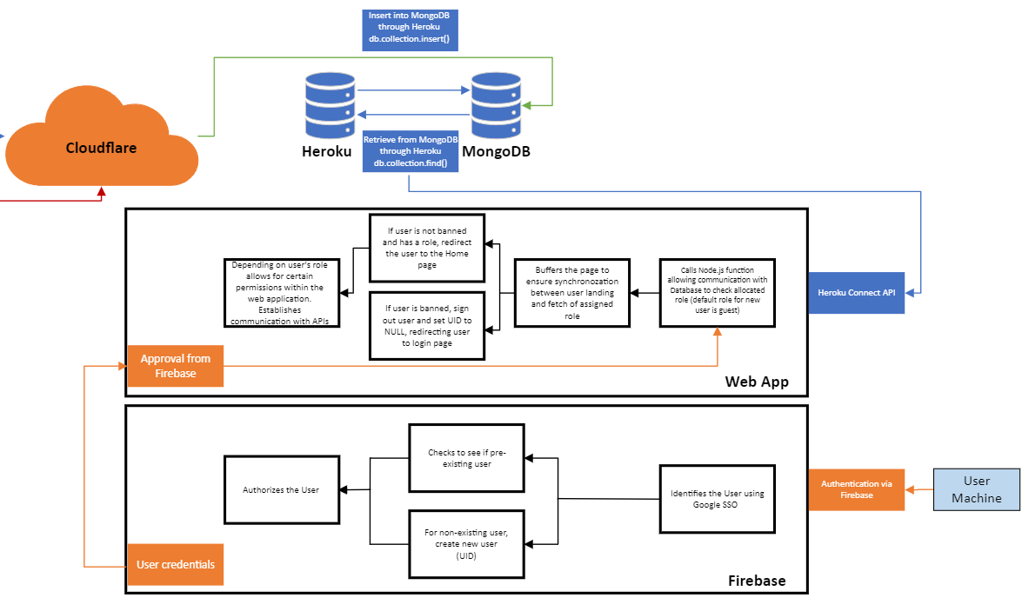
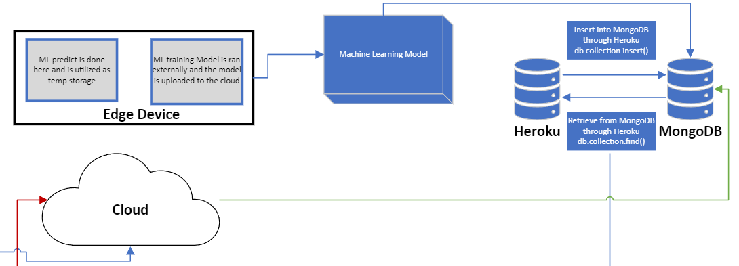
System Architecture (cont.)
Notes:
CM
Explain Firebase
Explain Web app process
Hosted by Heroku and linked to Database

Slide 28



Bridge

Slide 29
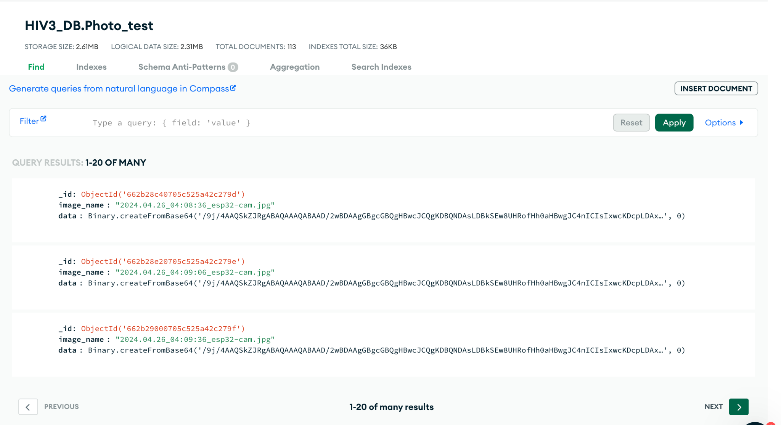
Cloud Database
Collections
Images
User Data
ML Results
Camera Addresses
Notes:
CM
In our Database we have 4 collections
Go into each one

Slide 30
Web Hosting
Heroku:
Allows for Public Hosting IP
Communicates with MongoDB
Implements Security Standards
Heroku Dynos
Notes:
CM
To host web app we use Heroku
Easy to integrate with MongoDB
Uses Standard Web Security
Easy to update with Heroku’s Dynos
Heroku Dynos = Easy to Update

Slide 31
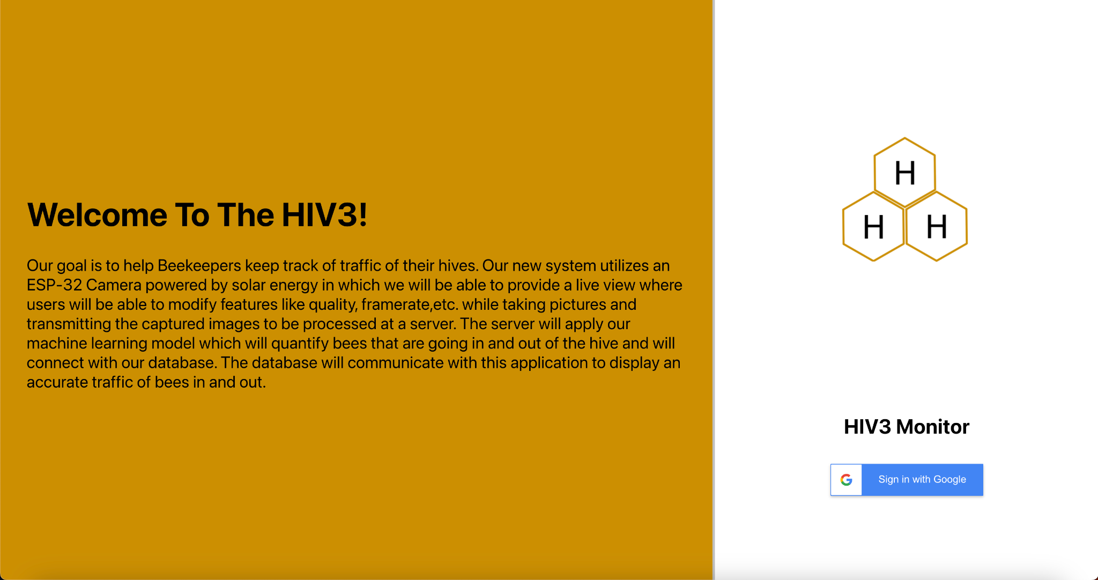
User Interface
Pages
Sign Up
Home Page
User Profile
Manage Camera
Live View
View Data
Notes:
CM:
For the web app we have 6 main pages
Go into each page.

Slide 32
Demo
Hiv3

Slide 33
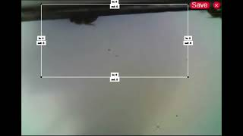
https://www.youtube.com/watch?v=kb2Gad74b8k

Slide 34
Testing and Evaluation
Hiv3

Slide 35
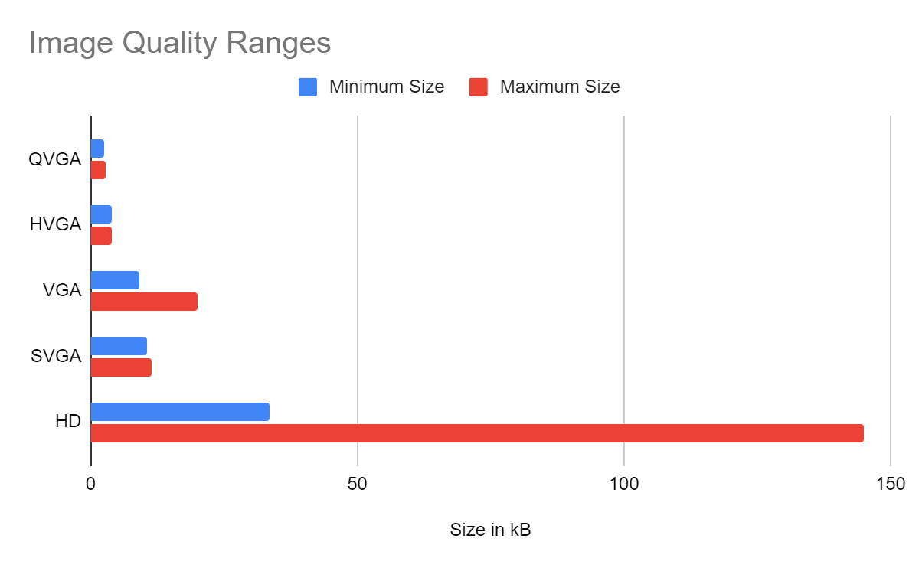
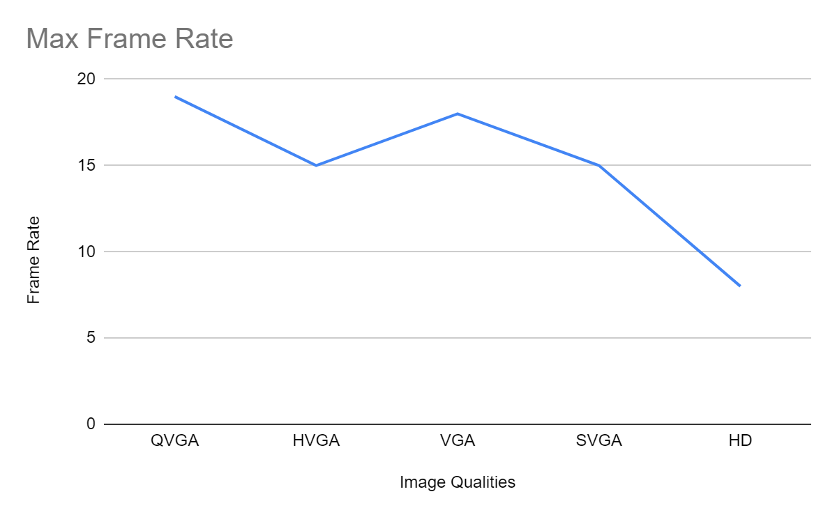
Image Sweet Spot
Images come in various qualities
Higher Quality = Lower Frame Rate
Optimal Capture?
Notes:
AK

Slide 36
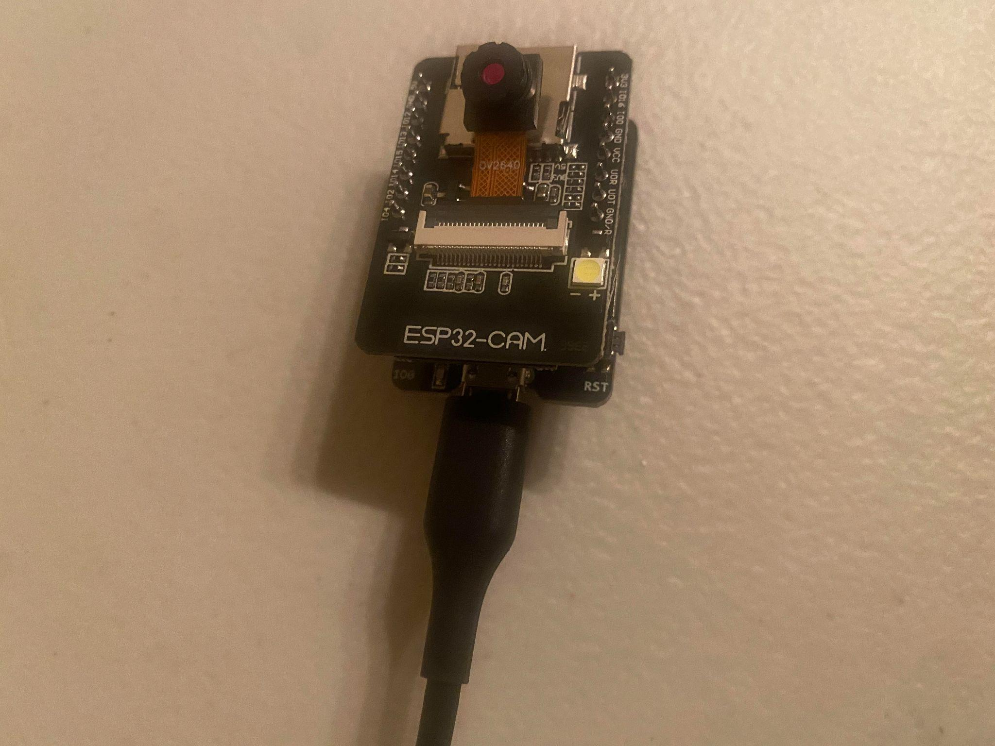
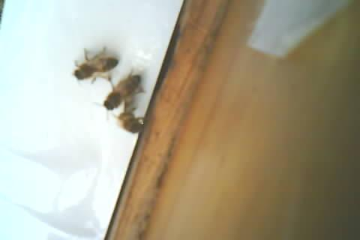
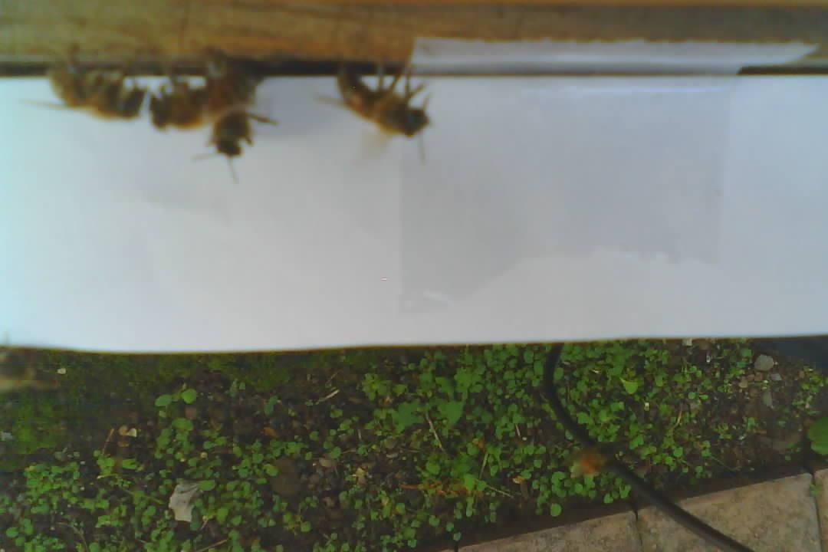
Deployment / Data during past visits
Model:
ESP32 camera & board
Running uploaded code
Mounted over beehive entrance
Data Collected:
Picture taken every second
Taken in different resolutions: VGA, QVGA,HD
~100 VGA, ~900 QVGA, ~1000+ HD
Notes:
AK

Slide 37
Impact
Economic
Low cost system for beekeepers
Environmental
Camera deep sleeps to conserve energy
Sustainability
Fully solar powered system
Manufacturability
Open source code compatible with user interface
Ethical
Non-invasive monitoring
Health and Safety
Ensures healthy beehive
Social
Allows users to save images and able to share
Notes:
AK

Slide 38
Future Work
Hiv3

Slide 39
Future Work
Test and train ML with more diverse images
Try the newest ESP32 Camera module
Establish more consistent connection between Wi-Fi and camera
UI preference changes (dark mode, etc)
Notes:
CM

Slide 40
Questions?
Hiv3
Notes:
All

Slide 41
Thank You!

Slide 42
References
Algorithm principles and implementation with YOLOv8 — MMYOLO 0.6.0 documentation. (2022). Mmyolo.readthedocs.io. https://mmyolo.readthedocs.io/en/latest/recommended_topics/algorithm_descriptions/yolov8_description.html
apic.ai | Agroscience. (n.d.). Apic.ai. Retrieved May 5, 2024, from https://apic.ai/agroscience.html
Every Hive Counts. (n.d.). IF, LLC. https://broodminder.com/
Eyesonhives Scout B - Beehive Monitor. (2015, December 26). Eyesonhives. https://www.eyesonhives.com/product/eyesonhives-scout/
Sienkiewicz, A. (2022, June 20). Project risk assessment: an example with a risk matrix template. BigPicture. https://bigpicture.one/blog/project-risk-assessment-examples/
wjsanek. (2024, January 30). wjsanek/wjsanek. GitHub. https://github.com/wjsanek/wjsanek

